Slide 1
Compositing and Blending
Matt Evett
Dept. of Computer Science
Eastern Michigan University

Slide 2
Objectives
Learn to use the A component in RGBA color for
  Blending for translucent surfaces
  Compositing images
  Antialiasing
Compositing © Matt Evett 2004 & Addison-Wesley 2002

Slide 3

Opacity and Transparency
Opaque surfaces permit no light to pass through
Transparent surfaces permit all light to pass
Translucent surfaces pass some light
translucency = 1 – opacity (α)
opaque surface α =1
Compositing © Matt Evett 2004 & Addison-Wesley 2002

Slide 4
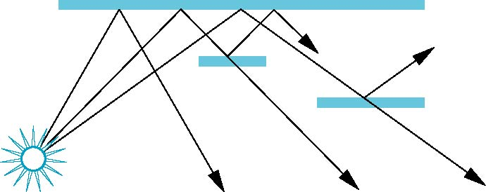
Physical Models
Dealing with translucency in a physically correct manner is difficult due to
  the complexity of the internal interactions of light and matter
  Using a pipeline renderer
  Revert to writing model
Compositing © Matt Evett 2004 & Addison-Wesley 2002

Slide 5
Writing Model
Use A component of RGBA (or RGBα) color to store opacity
During rendering we can expand our writing model to use RGBA values
blend
source blending factor
source
component
destination
component
destination blending
factor
Color Buffer
Compositing © Matt Evett 2004 & Addison-Wesley 2002

Slide 6
Blending Equation
Source and destination pixels (RGBA)
s = [s_{r}, s_{g}, s_{b}, s_{α}]
d = [d_{r}, d_{g}, d_{b}, d_{α}]
We can define source and destination blending factors for each component
b = [b_{r}, b_{g}, b_{b}, b_{α}]
c = [c_{r}, c_{g}, c_{b}, c_{α}]
Blend as
d’=[b_{r} s_{r}+ c_{r} d_{r}, b_{g} s_{g}+ c_{g} d_{g} , b_{b} s_{b}+ c_{b} d_{b} , b_{α} s_{α}+ c_{α} d_{α} ]
Compositing © Matt Evett 2004 & Addison-Wesley 2002

Slide 7
OpenGL Blending and Compositing
Must enable blending and pick source and destination factors
glEnable(GL_BLEND)
glBlendFunc(source_factor,
destination_factor)
Only certain factors supported
  GL_ZERO, GL_ONE
  GL_SRC_ALPHA, GL_ONE_MINUS_SRC_ALPHA
  GL_DST_ALPHA, GL_ONE_MINUS_DST_ALPHA
  See Redbook for complete list
Compositing © Matt Evett 2004 & Addison-Wesley 2002

Slide 8
Example
Suppose that we start with the opaque background color (R₀,G₀,B₀,1)
  This color becomes the initial destination color
We now want to blend in a translucent polygon with color (R₁,G₁,B₁,α₁)
Select GL_SRC_ALPHA and GL_ONE_MINUS_SRC_ALPHA as the source and destination blending factors
R’₁ = α₁ R₁ +(1- α₁) R_{0,} ……
Note this formula is correct if polygon is either opaque or transparent
Compositing © Matt Evett 2004 & Addison-Wesley 2002

Slide 9
Clamping and Accuracy
All the components (RGBA) are clamped and stay in the range (0,1)
However, in a typical system, RGBA values are only stored to 8 bits
  Can easily loose accuracy if we add many components together
  Example: add together n images
    Divide all color components by n to avoid clamping
    Blend with source factor = 1, destination factor = 1
    But division by n loses bits
Compositing © Matt Evett 2004 & Addison-Wesley 2002

Slide 10
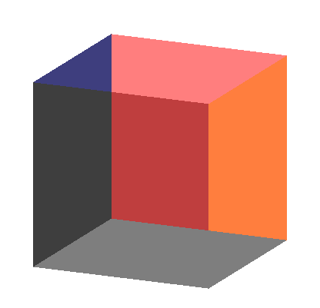
Order Dependency
Is this image correct?
  Probably not
  Polygons are rendered
  in the order they pass
  down the pipeline
  Blending functions
  are order dependent
Compositing © Matt Evett 2004 & Addison-Wesley 2002
Notes:
Depends on which sides were supposed to be translucent: a consistent interpretation would be the left is translucent and top is opaque, but perhaps these were reversed?

Slide 11
Opaque and Translucent Polygons
Suppose that we have a group of polygons some of which are opaque and some translucent
How do we use hidden-surface removal?
Opaque polygons block all polygons behind them and affect the depth buffer
Translucent polygons should not affect depth buffer
  Render these with glDepthMask(GL_FALSE) which makes depth buffer read-only
Sort polygons into “translucent” and not, render separate to remove order dependency
Compositing © Matt Evett 2004 & Addison-Wesley 2002
Notes:
Consider example with two orderings of three overlapping polygons, (O)paque and (T)ranslucent: OTO and TOT

Slide 12
Fog
Using the alpha component to good effect....
(Thanks to Henrik R. Nagel
hrn@cvmt.dk.)

Slide 13
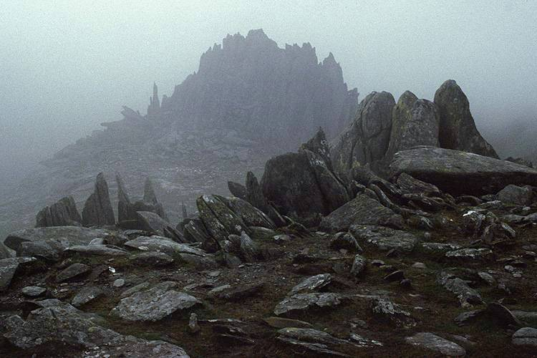
Fog – Real Example
Compositing © Matt Evett 2004 & Addison-Wesley 2002

Slide 14
Fog
Fog makes objects fade in the distance
It can be used to simulate haze, smoke, mist or pollution
You can control the density of the fog which determines the rate at which the objects fade into the fog’s color
Compositing © Matt Evett 2004 & Addison-Wesley 2002

Slide 15
Fog in OpenGL
OpenGL adds a color to each pixel
  the amount of that added color depends on depth
We blend the surface color C_{s} with the fog color C_{f} by:
C_{s}’ = f(d) C_{s} + (1-f(d)) C_{f}
where f is the fog function, which depends on the distance, d, to the object
the smaller f gets the more fog is shown
Compositing © Matt Evett 2004 & Addison-Wesley 2002

Slide 16
Fog Functions
In OpenGL the fog function, f, can be linear or exponential
  Linear yields simple depth cueing
  Exponential is fog-like:
where z is the distance to the object and d
is a density value, e.g:
Compositing © Matt Evett 2004 & Addison-Wesley 2002

Slide 17
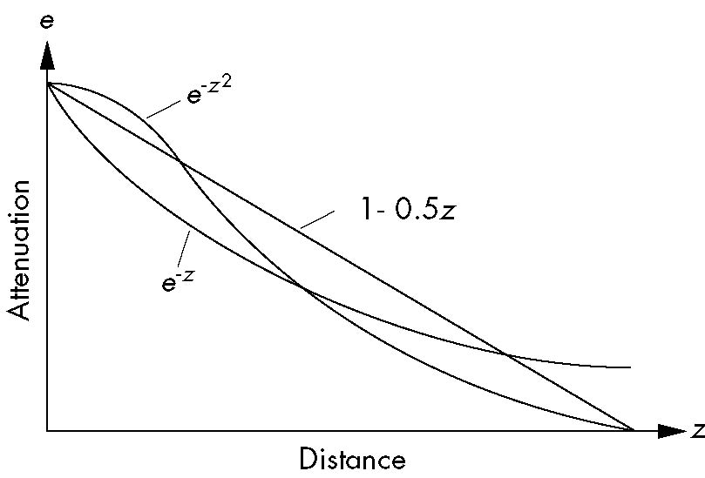
Fog Functions
Compositing © Matt Evett 2004 & Addison-Wesley 2002

Slide 18
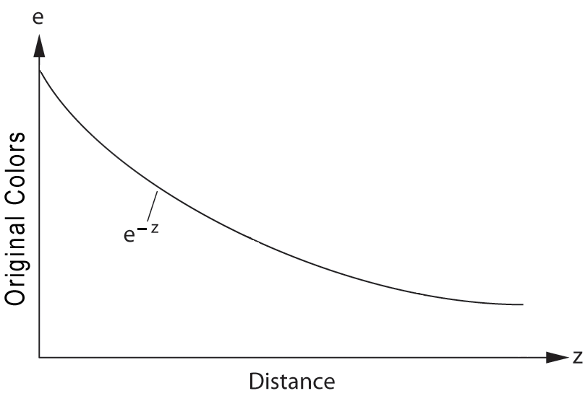
Exponential Fog
Compositing © Matt Evett 2004 & Addison-Wesley 2002

Slide 19
OpenGL Fog
To use fog in OpenGL we need to:
  Turn fog on
  Set the fog color
  Set the fog mode to be exponential
  Set the fog density
Compositing © Matt Evett 2004 & Addison-Wesley 2002

Slide 20
OpenGL Fog
Turn on fog
glEnable(GL_FOG);
Turn off fog
glDisable(GL_FOG);
Compositing © Matt Evett 2004 & Addison-Wesley 2002

Slide 21
OpenGL Fog
Set the fog color
// define the color of the fog, white
GLfloat fogColor[4] = {1,1,1,1};
// set the color of the fog
glFogv(GL_FOG_COLOR, fogColor);
Compositing © Matt Evett 2004 & Addison-Wesley 2002

Slide 22
OpenGL Fog
Set the fog mode to be exponential
glFogf(GL_FOG_MODE, GL_EXP);
Compositing © Matt Evett 2004 & Addison-Wesley 2002

Slide 23
OpenGL Fog
Set the fog density
glFogf(GL_FOG_DENSITY, 0.5);
Compositing © Matt Evett 2004 & Addison-Wesley 2002

Slide 24
OpenGL Fog Functions
GLfloat fcolor[4] = {……}:
glEnable(GL_FOG);
glFogf(GL_FOG_MODE, GL_EXP);
glFogf(GL_FOG_DENSITY, 0.5);
glFOgv(GL_FOG, fcolor);
Compositing © Matt Evett 2004 & Addison-Wesley 2002

Slide 25
Fog, Summary
We can composite with a fixed color and have the blending factors depend on depth
  Simulates a fog effect
Blend source color C_{s} and fog color C_{f} by
C_{s}’=f C_{s} + (1-f) C_{f}
f is the fog factor
  Linear (depth cueing)
  Exponential (looks more like fog)
  Gaussian
See Color Plate 11 in book
See Fog demo
Compositing © Matt Evett 2004 & Addison-Wesley 2002

Slide 26
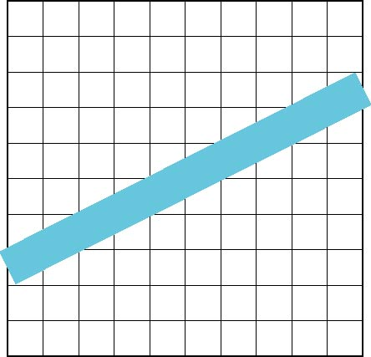
Line Aliasing
Ideal raster line is one pixel wide
All line segments, other than vertical and horizontal segments, partially cover pixels
Simple algorithms color
only whole pixels
Leads to “jaggies”
or aliasing
Similar issue for polygons
Compositing © Matt Evett 2004 & Addison-Wesley 2002

Slide 27
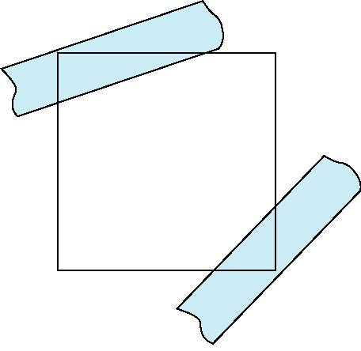
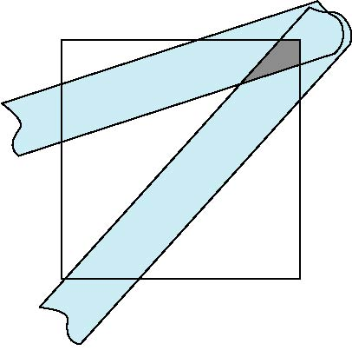
Antialiasing
Can try to color a pixel by adding a fraction of its color to the frame buffer
  Fraction depends on percentage of pixel covered by fragment
  Fraction depends on whether there is overlap
no overlap
overlap
Compositing © Matt Evett 2004 & Addison-Wesley 2002

Slide 28
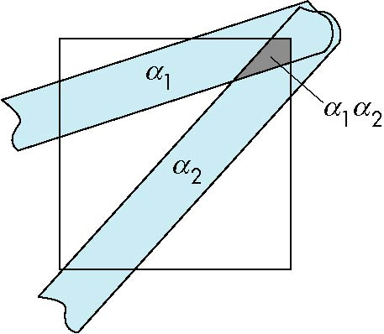
Area Averaging
Use average area α₁+α₂-α₁α₂ as blending factor
Compositing © Matt Evett 2004 & Addison-Wesley 2002

Slide 29
OpenGL Antialiasing
Can enable separately for points, lines, or polygons
glEnable(GL_POINT_SMOOTH);
glEnable(GL_LINE_SMOOTH);
glEnable(GL_POLYGON_SMOOTH);
glEnable(GL_BLEND);
glBlendFunc(GL_SRC_ALPHA, GL_ONE_MINUS_SRC_ALPHA);
Compositing © Matt Evett 2004 & Addison-Wesley 2002

Slide 30
Limitation of Depth Resolution
Compositing and blending are limited by resolution of the frame buffer
  Typically 8 bits per color component
Consider problem of compositing 64 images.
Simply adding the results will usually clamp out the pixel colors.
If we simply normalize each image by dividing its color values by 64, we lose most of the color resolution.
Compositing © Matt Evett 2004 & Addison-Wesley 2002

Slide 31
Accumulation Buffer
The accumulation buffer is a high resolution buffer (16 or more bits per component) that avoids this problem
Write into it or read from it with a scale factor
Slower than direct compositing into the frame buffer
Compositing © Matt Evett 2004 & Addison-Wesley 2002

Slide 32
Example use of Accumulation Buffer
Clear the accumulation buffer, then “render” into it
glClear(GL_ACCUM_BUFFER_BIT);
for(i=0;i< numImages; i++) {
glClear(GL_COLOR_BUFFER_BIT|GL_DEPTH_BUFFER_BIT);
displayImage(i);
glAccum(GL_ACCUM,1.0/(float)numImages);
}
glAccum(GL_RETURN,1.0); //Copies result to write buffer
Compositing © Matt Evett 2004 & Addison-Wesley 2002

Slide 33
Applications
Compositing
Image Filtering (convolution)
Whole scene antialiasing
  Multi-renders “jiggled” images (by a few pixels) and averages the results.
Motion effects
Compositing © Matt Evett 2004 & Addison-Wesley 2002

